Slide 1

FLOWPILOT
AI-Powered Productivity Tracker
🌐 Local-first · 🔒 Privacy-Respecting · 🧠 AI Smart · 🎯 Reward-Driven
🚀 Hackathon: HACKHAZARDS
🗓️ Date: 11-25 April 2025
Heckhazards Hackethon

Slide 2


THE PROBLEM
Too many distractions while working/studying remotely
Time gets lost across apps without awareness
Users want productivity insights without sacrificing privacy
Existing tools:
Track everything in cloud
Too invasive or hard to customize
Use icons for distractions (YouTube, WhatsApp), show side-by-side comparison
Heckhazards Hackethon

Slide 3

OUR SOLUTION — FLOWPILOT
FlowPilot is...
A real-time focus tracker that:
Logs your screen/app/audio locally using Terminator
Uses AI (Groq + Whisper) to summarize your work
Gives you a daily productivity score
Optionally rewards you with tokens or NFTs via Base + Stellar
Heckhazards Hackethon

Slide 4

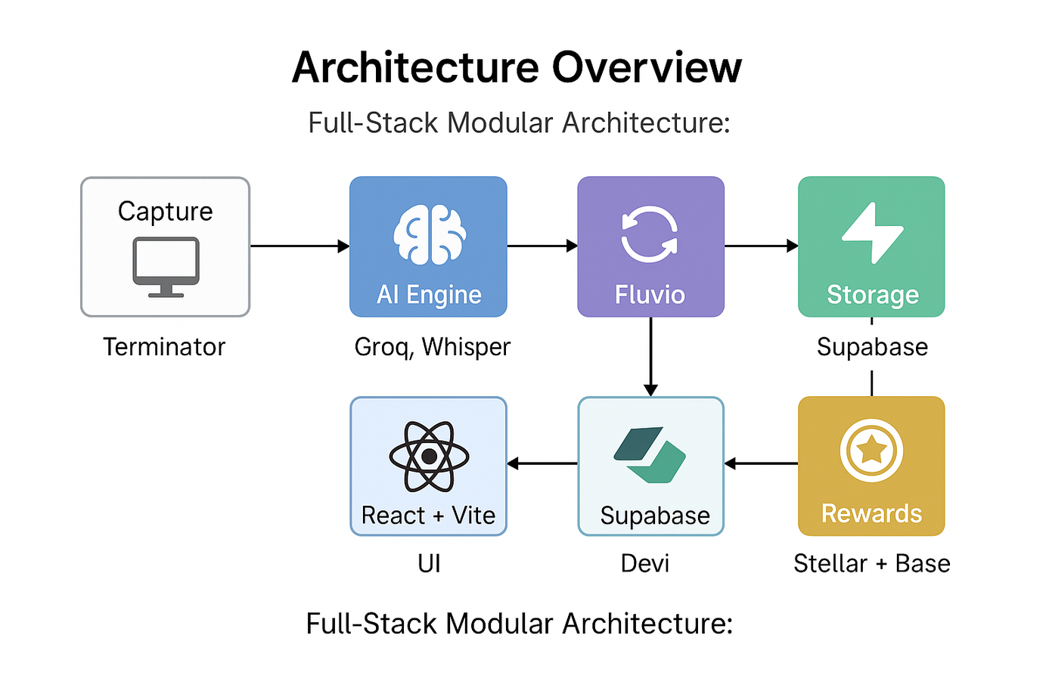
ARCHITECTURE OVERVIEW
Heckhazards Hackethon

Slide 5
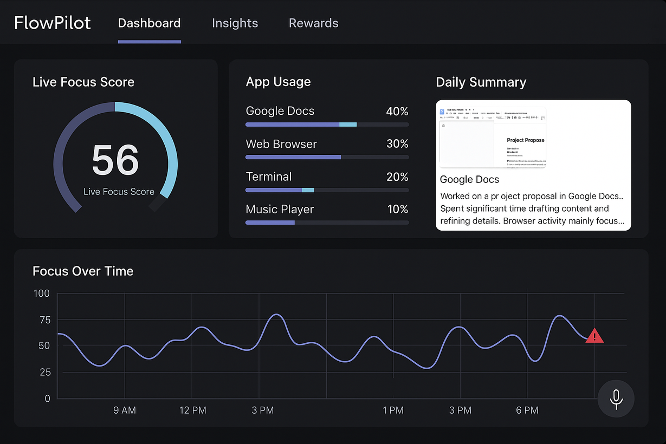
DEMO & FEATURES
🧠 What it does (Live):
📷 Captures app focus & screenshots
📝Extracts + summarizes screen content
📊Streams real-time focus score to dashboard
🏆 Issues daily Stellar rewards
🛡️ All local-first, modular, and clean
Heckhazards Hackethon

Slide 6
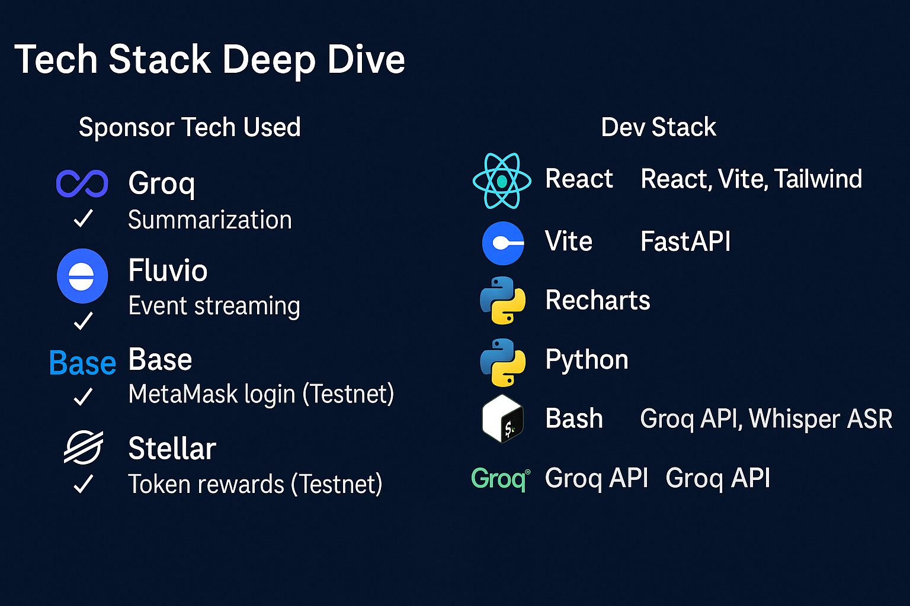
Heckhazards Hackethon

Slide 7
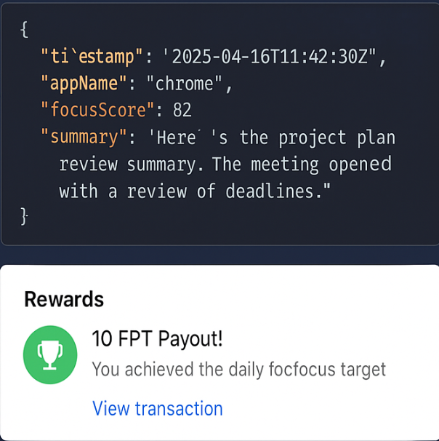
RESULTS & OUTPUT
Fully working end-to-end:
Focus Score: Real-time, reactive
OCR + Summary: Extracted from screen
Stellar Payout: 10 FPT daily goal hit
<300MB/week without media
All data processed locally
Heckhazards Hackethon

Slide 8

FUTURE SCOPE
🚀 What's Next:
Cross-device syncing (with encryption)
Smart distraction nudges
Emotion-aware scoring
Public opt-in leaderboards
Support for teams & orgs
Heckhazards Hackethon

Slide 9
THANK YOU!
FOR YOUR ATTENTION
Heckhazards Hackethon

